Slide 1
IF231 Pengantar Teknologi Internet
10 - React Data Rendering
Alexander Waworuntu, S.Kom., M.T.I. Fenina Adline Twince Tobing, S.Kom., M.Kom.

Slide 2

REVIEW
React Components
React Props
ES6 Import, Export & Modules
Local Environment Setup for React Development
React Developer Tools

Slide 3

TODAY’s OUTLINE
Mapping Data to Components
JavaScript ES6 Map/Filter/Reduce
JavaScript ES6 Arrow Function
React Conditional Rendering

Slide 4
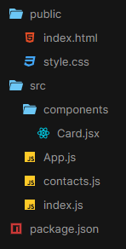
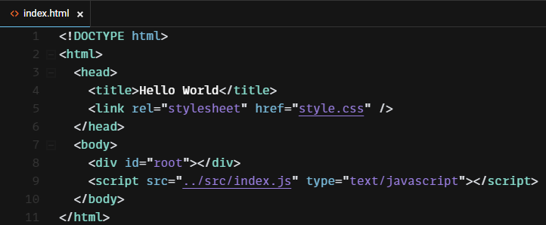
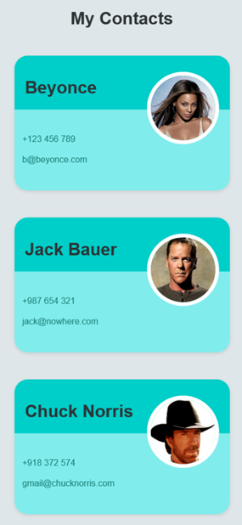
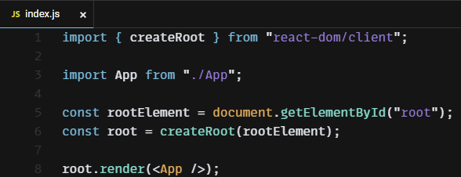
Review: React Components (1)

Slide 5
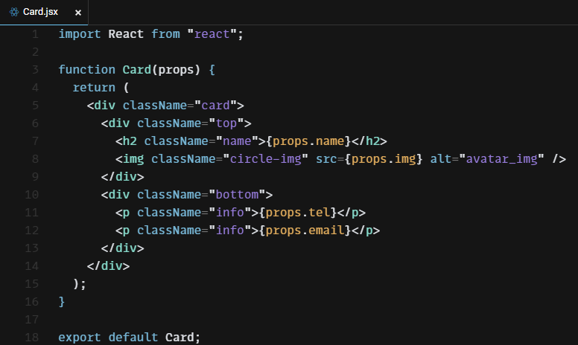
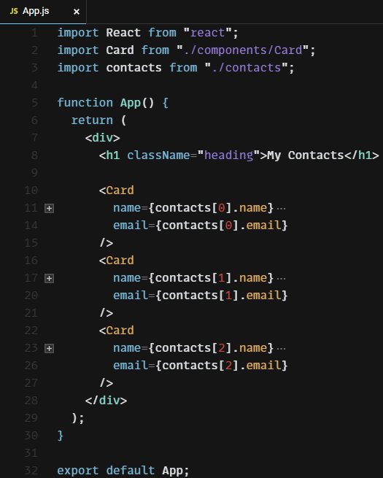
Review: React Components (2)

Slide 6
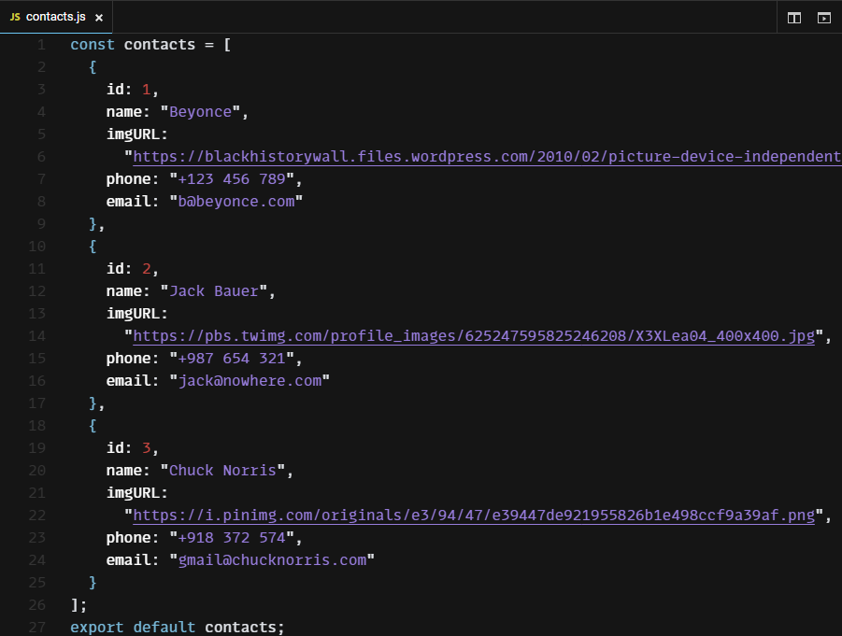
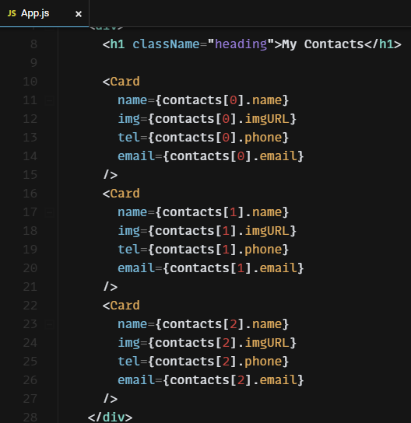
Mapping Data to Components (Before)
Its repetitive, writing the same code over and over.

Slide 7
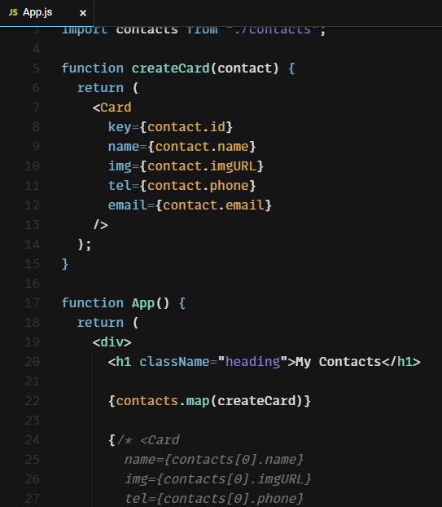
Mapping Data to Components (After)
map()
creates a new array from calling a function for every array element
calls a function once for each element in an array
does not execute the function for empty elements
does not change the original array

Slide 8
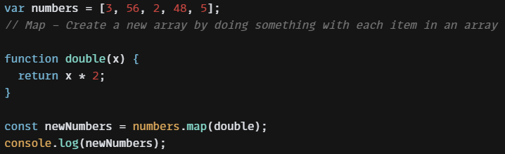
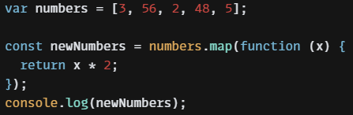
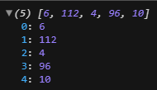
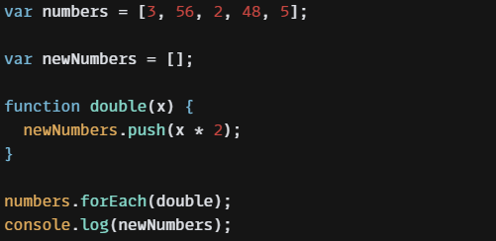
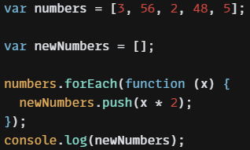
map() vs forEach()
Using anonymous function

Slide 9
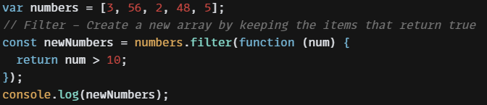

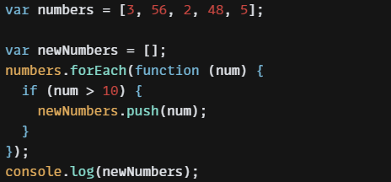
Filter
filter() method creates a new array filled with elements that pass a test provided by a function
filter() method does not execute the function for empty elements.
filter() method does not change the original array
same operation
using forEach()

Slide 10
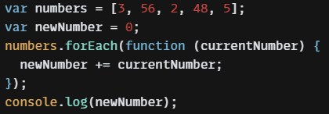
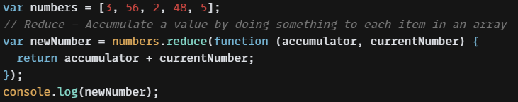
Reduce(1)
reduce() method executes a reducer function for array element.
reduce() method returns a single value: the function's accumulated result.
reduce() method does not execute the function for empty array elements.
reduce() method does not change the original array.
using forEach()
using reduce()

Slide 11
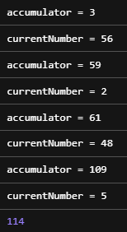
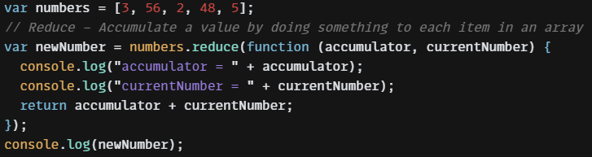
Reduce (2)

Slide 12
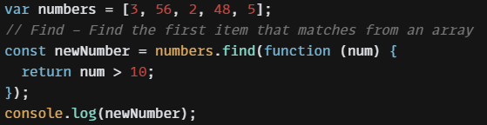
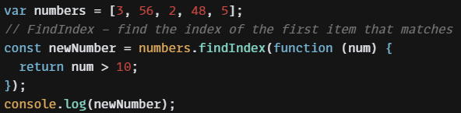
Find & FindIndex
find() method returns the value of the first element that passes a test.
find() method executes a function for each array element.
find() method returns undefined if no elements are found.
find() method does not execute the function for empty elements.
find() method does not change the original array.
findIndex() method executes a function for each array element.
findIndex() method returns the index (position) of the first element that passes a test.
findIndex() method returns -1 if no match is found.
findIndex() method does not execute the function for empty array elements.
findIndex() method does not change the original array.

Slide 13
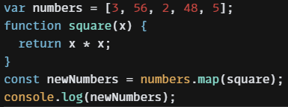
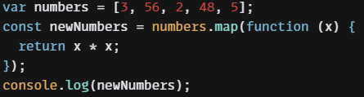
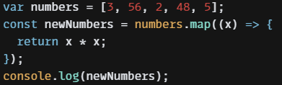

ES6 Arrow Function

Slide 14
ES6 Arrow Function
An arrow function expression is a compact alternative to a traditional function expression, but is limited and can’t be used in all situations.
There are differences between arrow functions and traditional functions, as well as some limitations:
Arrow functions don't have their own bindings to this or super, and should not be used as methods.
Arrow functions don't have access to the new.target keyword.
Arrow functions aren't suitable for call, apply and bind methods, which generally rely on establishing a scope.
Arrow functions cannot be used as constructors.
Arrow functions cannot use yield, within its body.

Slide 15
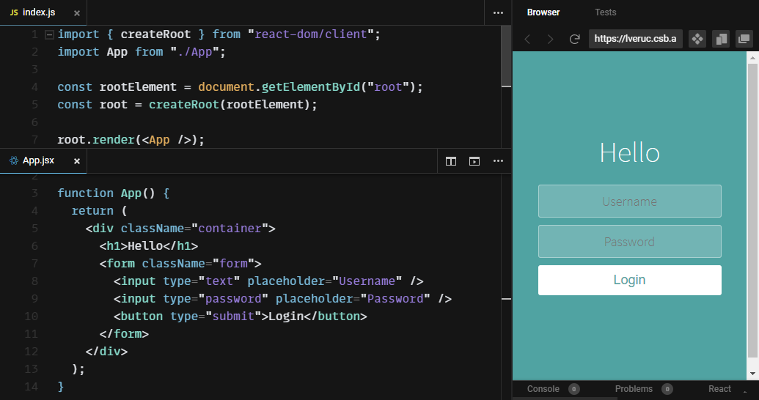
React Conditional Rendering (Before)

Slide 16
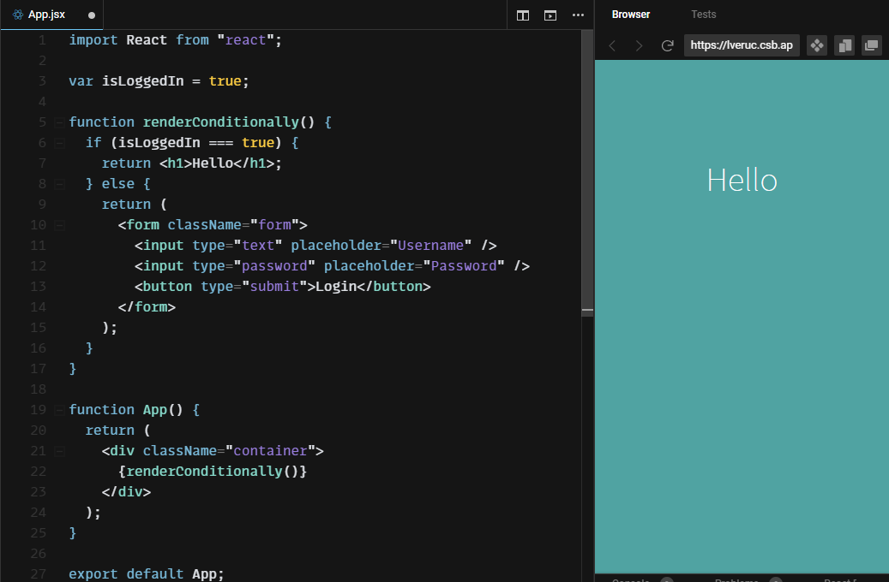
React Conditional Rendering (After)(1)

Slide 17
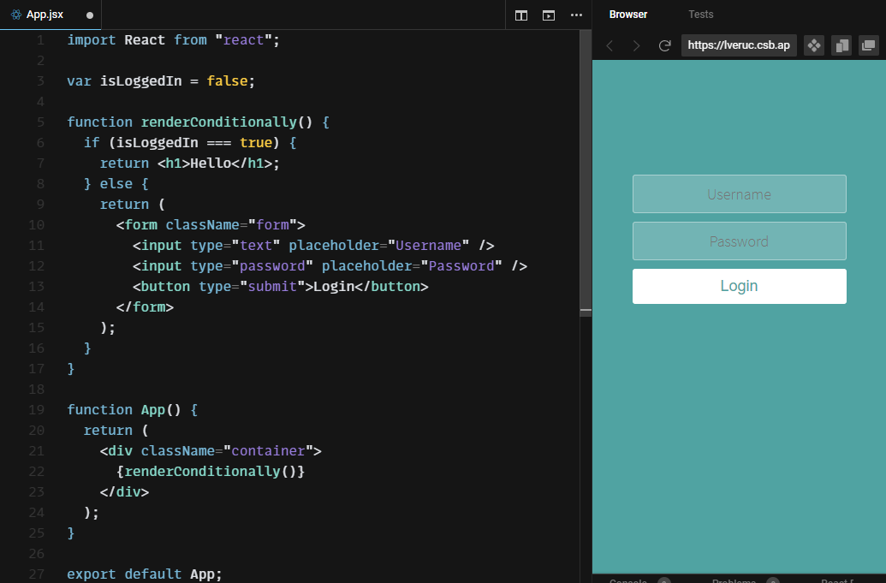
React Conditional Rendering (After)(2)

Slide 18
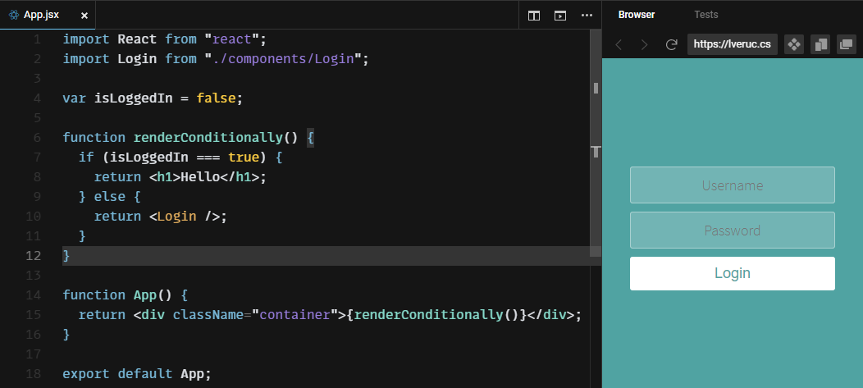
React Conditional Rendering (After)(3)

Slide 19
Ternary Operator
CONDITION ? DO IF TRUE : DO IF FALSE
isCloudy === true ? bringUmberella() : bringSunscreen()

Slide 20
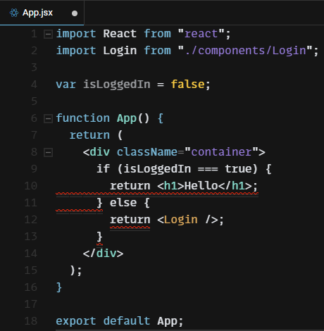
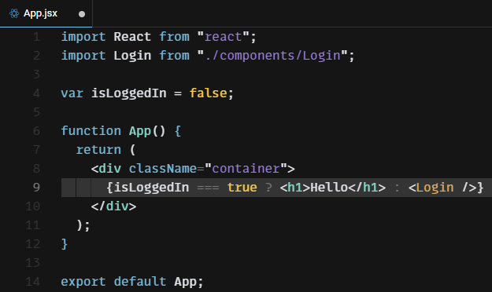
Using Ternary Operator to Convert Statement into Expression
ERROR!
Can not use JS Staement inside JSX

Slide 21
AND (&&) Operator
&& in JS
(EXPRESSION && EXPRESSION)
var x = 1;
(x > 3 && x < 7)
false
&& in React
CONDITION && EXPRESSION
true && EXPRESSION
false && EXPRESSION

Slide 22
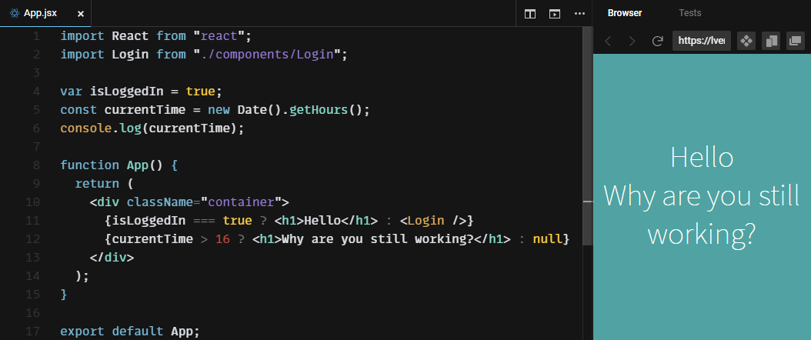
Using Ternary Operator Example

Slide 23
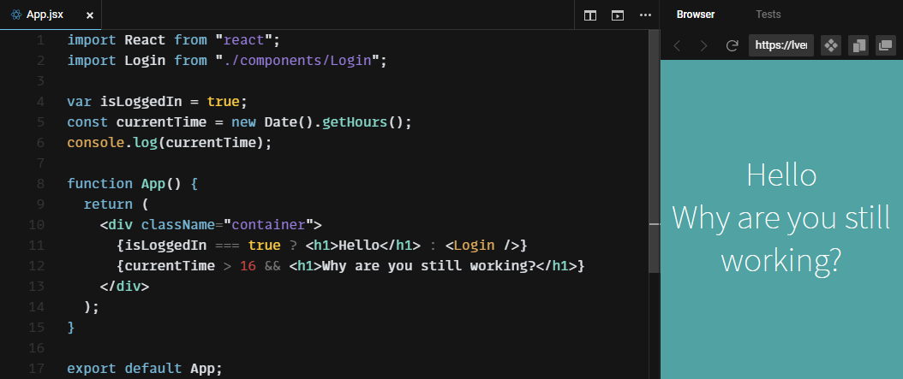
Using AND Operator Example

Slide 24

SUMMARY
After finishing this module, you should be able to:
understand how to mapping data to components
understand how to implement ES6 Map/Filter/Reduce function
understand how to implement ES6 Arrow Function
understand how to implement conditional rendering

Slide 25

NEXT WEEK’s OUTLINE
Mapping Data to Components
ES6 Map, Filer, Reduce
ES6 Arrow Function
React Conditional Rendering

Slide 26

REFERENCES
https://developer.mozilla.org/en-US/docs/Web/JavaScript/Reference/Global_Objects/Array/filter
https://developer.mozilla.org/en-US/docs/Web/JavaScript/Reference/Global_Objects/Array/map
https://developer.mozilla.org/en-US/docs/Web/JavaScript/Reference/Global_Objects/Array/reduce
https://developer.mozilla.org/en-US/docs/Web/JavaScript/Reference/Global_Objects/Array/find
https://developer.mozilla.org/en-US/docs/Web/JavaScript/Reference/Global_Objects/Array/findindex
https://hacks.mozilla.org/2015/06/es6-in-depth-arrow-functions/
https://developer.mozilla.org/en-US/docs/Web/JavaScript/Reference/Operators/Conditional_Operator
https://reactjs.org/docs/conditional-rendering.html#inline-if-with-logical--operator

Slide 27


